Slide 1
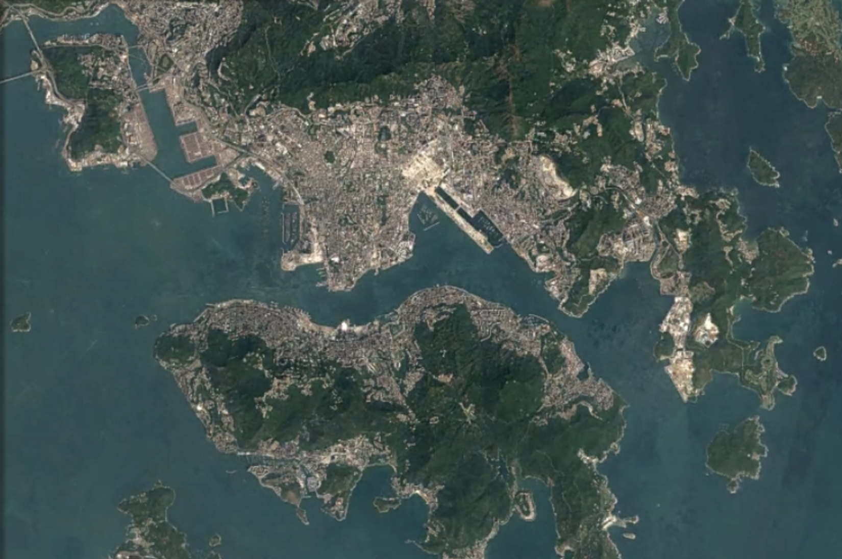
Fun with Satellites
Day 2 -
CubeSats
Notes:
More notes can be found in this document
https://docs.google.com/document/d/1RRAOangkTDCs99CzeFKNPicKLgnpoW0JCyOKtjVomTU/edit?usp=sharing

Slide 2
Schedule of the day
9:30AM - 9:35AM
Ice breaker (something with space?) and intro to events of the day
9:35AM - 9:50AM
Lecture: Introduction to Space Missions and CubeSats
9:50AM - 10:05AM
Student Activity : draw a space patch
10:05AM - 10:15AM
Share out : Space Patches
10:15AM - 10:30AM
Break
10:30AM - 10:55AM
Student Activity : Build a CubeSat
10:55AM - 11:15AM
Student Activity : Test CubeSat sensors in classroom
11:15AM - 12:00PM
Student Activity: Balloon launch of CubeSats

Slide 3
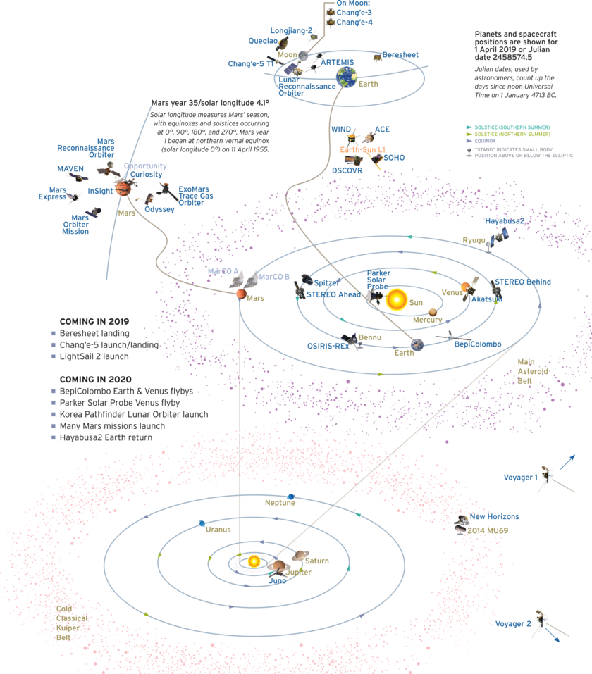
Satellite Missions
What is the purpose of these missions?
Who designs them?
What are some of the results?
The Planetary Society
Notes:
Try and get a lot of answers from the students for these questions!
Emphasize the change over time of this technology! Satellites started in 1957 with Sputnick and have come very far since! As we have gotten better at rocket design, satellite design, computer hardware, and sensing systems we are now able to produce and how that has allowed us to expand from using satellites as methods of communication to give us new insights into lots of parts of our universe.
Examples of satellites: [1] communication/internet [2] GPS [3] weather [4] exploring other planets (pictures chemical compositions, weather) [5] looking for explanets [6] tracking space objects

Slide 4
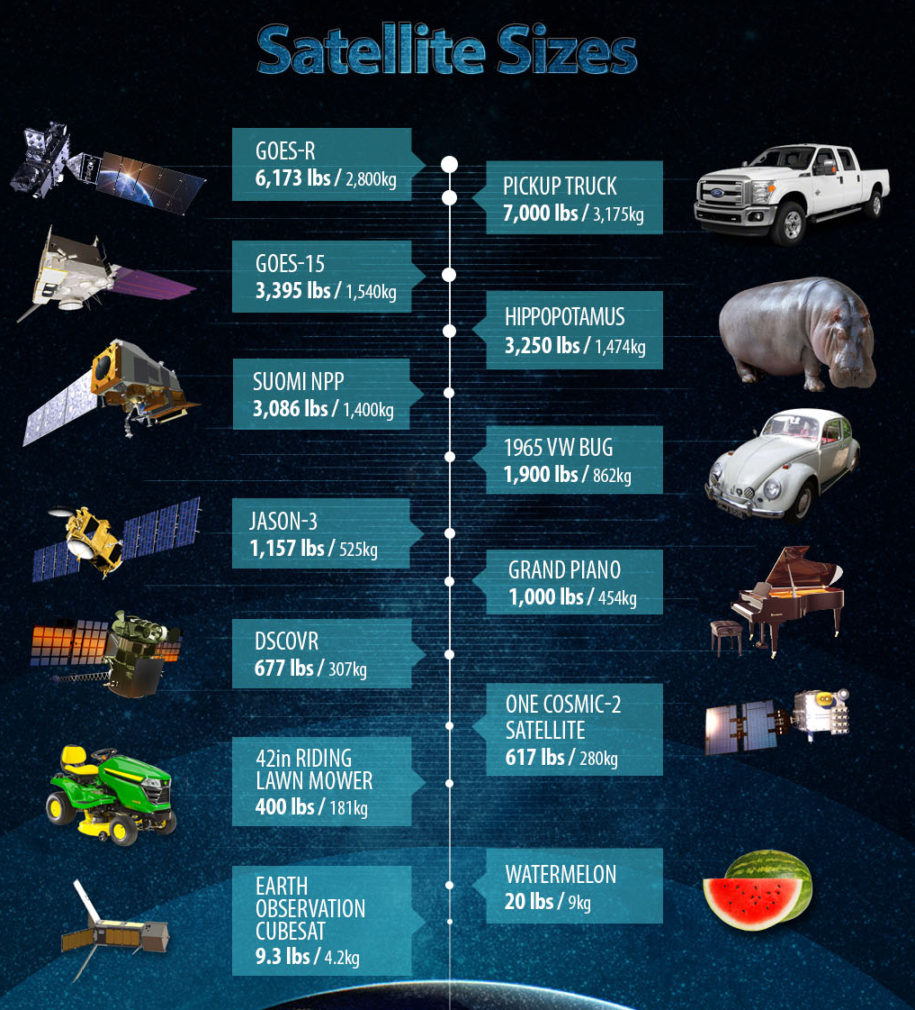
Satellite vary in size!
Satellites can be big, expensive, and long term projects--
but now they can also be small, cheaper, and short term with big impact!
NOAA
Notes:
Ask what the benefits of having a big satellite over a small one is (more room for experiments, more room for power, more room for important hardware guts, longer lifetime, etc) and how a smaller cubesat could be most useful (a specific mission, a risky mission, etc)

Slide 5
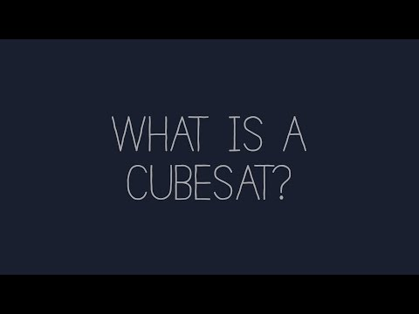
CubeSats
Notes:
Show video!

Slide 6
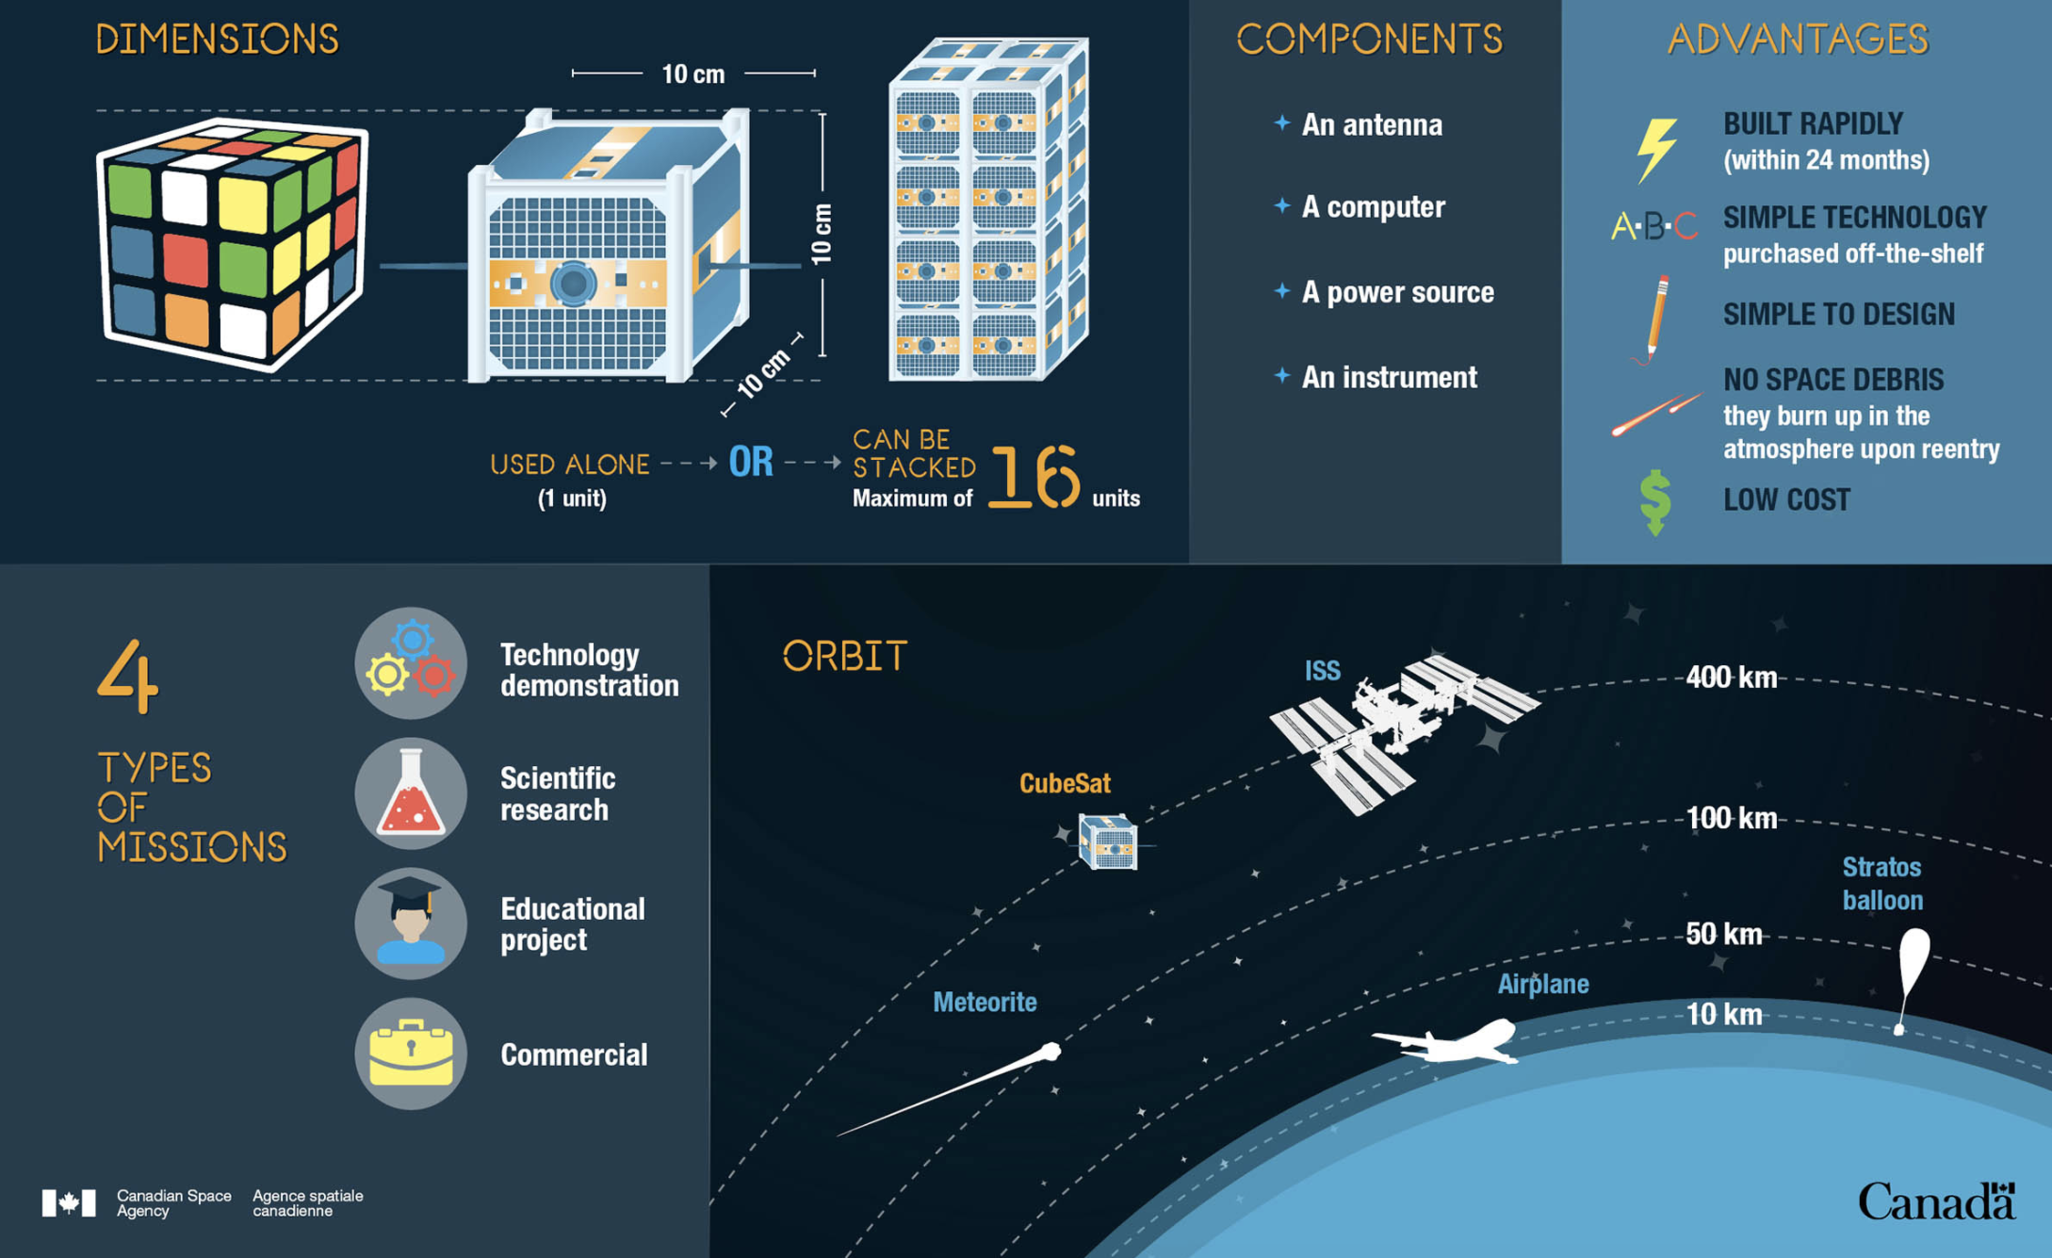
CubeSats
Canadian Space Agency
Notes:
Go into more detail about what these satellites are and where they live and what they are used for and why they are great!
These cubesats are quicker to build, but have a shorter lifespan. They have standardized bodies and sizes but are more experimental with their payloads. They can be linked together to form a constellation instead of just one satellite. They do not usually add to space junk! They can be made and deployed by hobbyists, universities, private companies, and governments (much more accessible than traditional satellites)

Slide 7
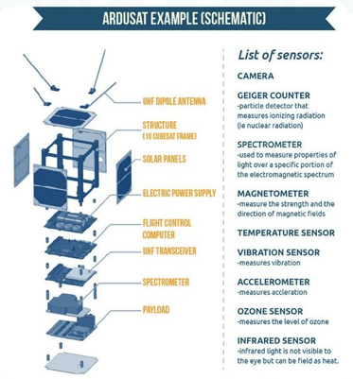
CubeSat Subsystems
A CubeSat contains many components that can be broken into six major subsystems:
Mechanical
Radio communication
Power and electrical
Software and data handling
Payload (sensors)
Notes:
Further details on all of the components necessary to build a cubesat (the recipe). We will try and mimic all of these in our cubesat design activity today! Next slide will have images for all of these, but you can ask the class whether they expect only one person to do all of this, or if it requires many people with many types of expertice!

Slide 8
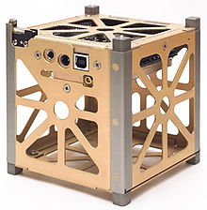
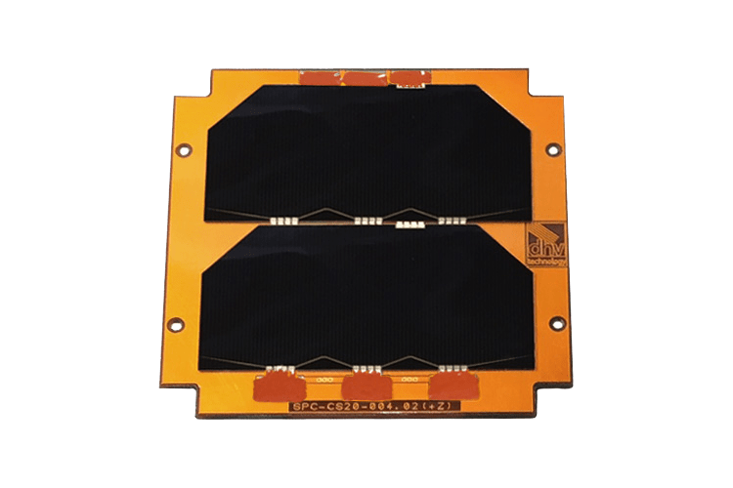
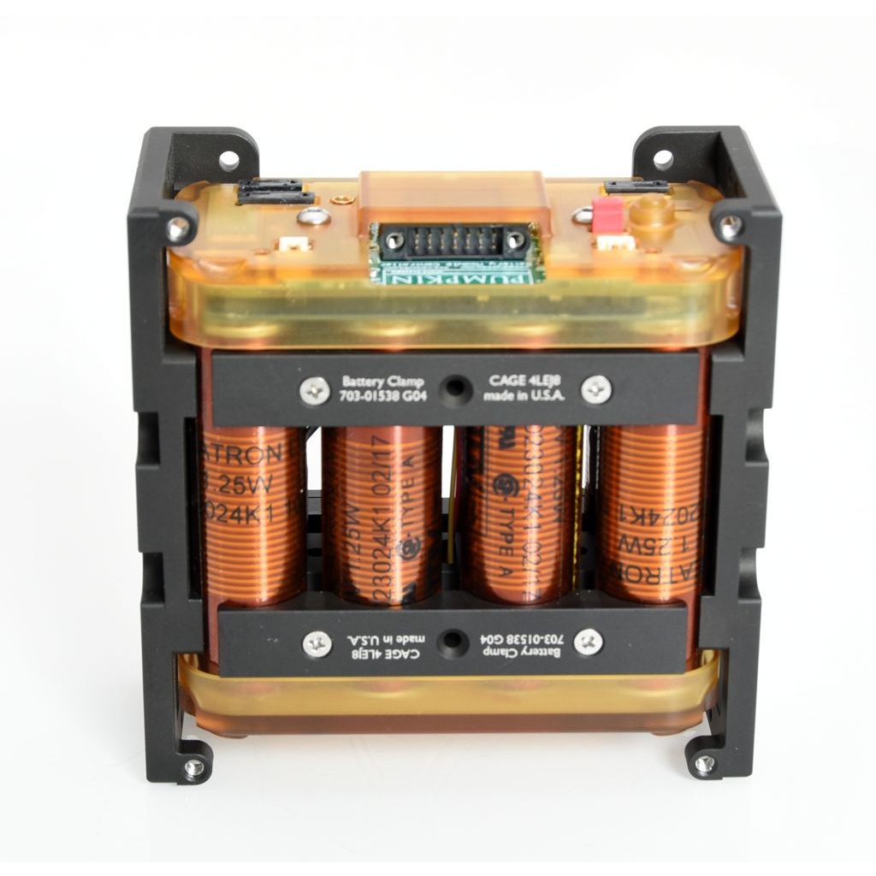
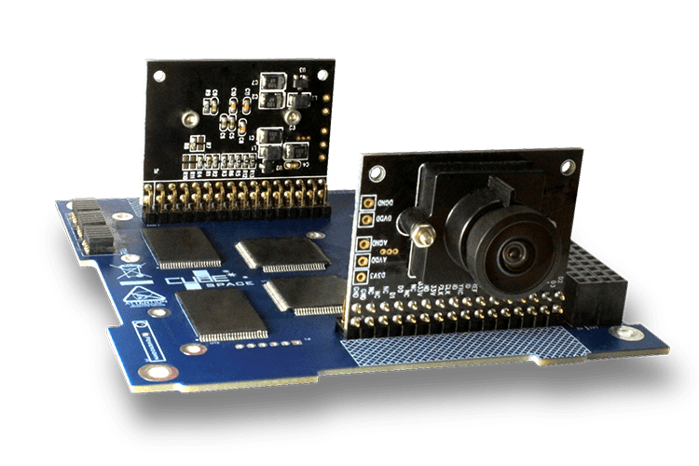
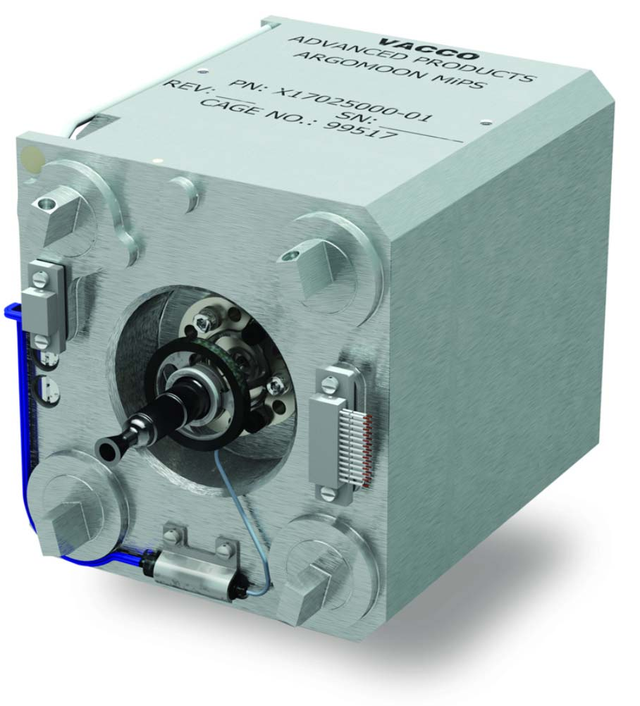
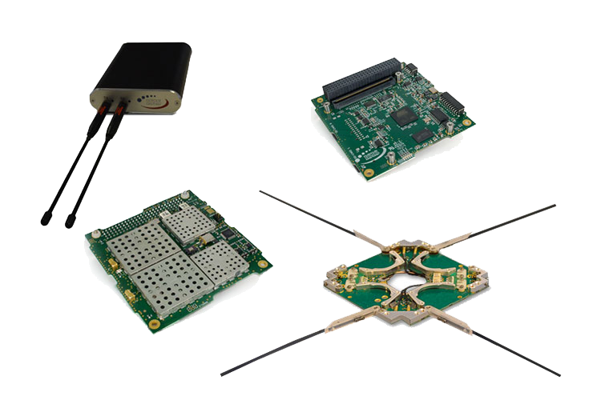
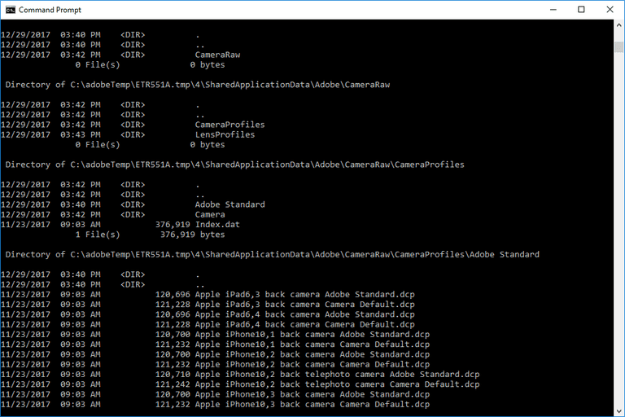
CubeSat Subsystems
Mechanical
Power and Electrical
Payload
Radio Communication
Software
Notes:
Mechanical consists of things like the body and the hardware of the cubesat (and making sure everything can fit in the small space!)
Power and electrical deal with methods of harvesting and storing energy for the satellites (there are no outlets to plug into while floating in space)
Payload deals with what the job of your satellite is (testing a new system or device in space environment, a camera, a chemical sensor, a reaction chamber, etc)
Radio communication is how a satellite communicates with the ground (earth) and how it sends information it has collected down to earth!
Software deals with the programming that connects all of these systems and also can be used to program different protocols to execute depending on the environment to make sure that the cubesat is prepared for all situations and works smoothly during its mission.

Slide 9
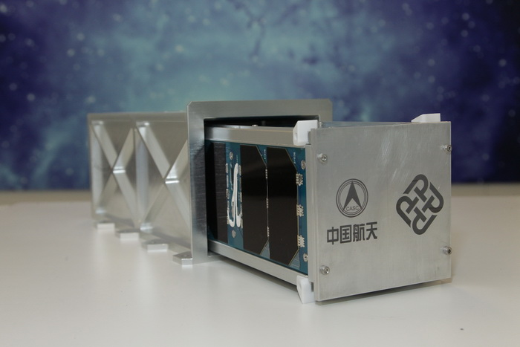
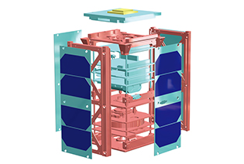
CubeSats in the field
Kaituo 1B
Notes:
Not only does"Kaituo-1B" belong to the first batch of microsatellite (CubeSat) launched by China, but it also is the very first microsatellite platform and deployment system successfully developed by Hong Kong. Compared to conventional satellites which weigh from a few hundreds to a few thousands kilograms each, "Kaituo-1B" only weighs around two kilograms, which results in significant cost reduction in the development and production of microsatellite for carrying small-sized payloads and instruments into space.
https://www.polyu.edu.hk/web/en/media/media_releases/index_id_6174.html
The mission of "Kaituo-1B" is to perform a series of verification tests and experiments in space, including performing experiments for the "Integrated Experimental Payload" designed by Dr. Cheng Ching-hsiang, Assistant Professor of PolyU's Department of Industrial and Systems Engineering and his team. The objective was to monitor ground images, space particles and chamber environment.The designed life span of "Kaituo-1B" is three months, and it is expected to de-orbit eight years later and return to the atmosphere without creating any space debris.
(https://www.polyu.edu.hk/web/en/media/media_releases/index_id_6174.html)

Slide 10

CubeSats in the field
Notes:
Another example is the MARCO mission to follow the InSight rover as it travels to Mars!

Slide 11
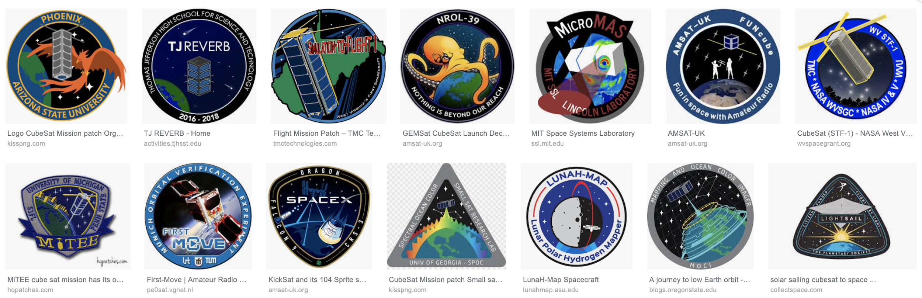

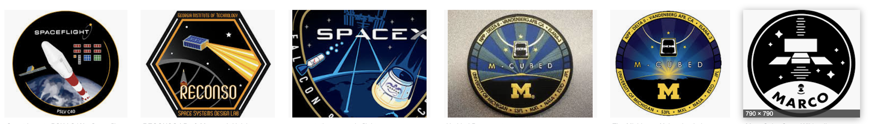
Activity - Design a mission patch
What do you think you can learn with cubesat that can help the people of Hong Kong?
Notes:
https://en.wikipedia.org/wiki/Mission_patch

Slide 12
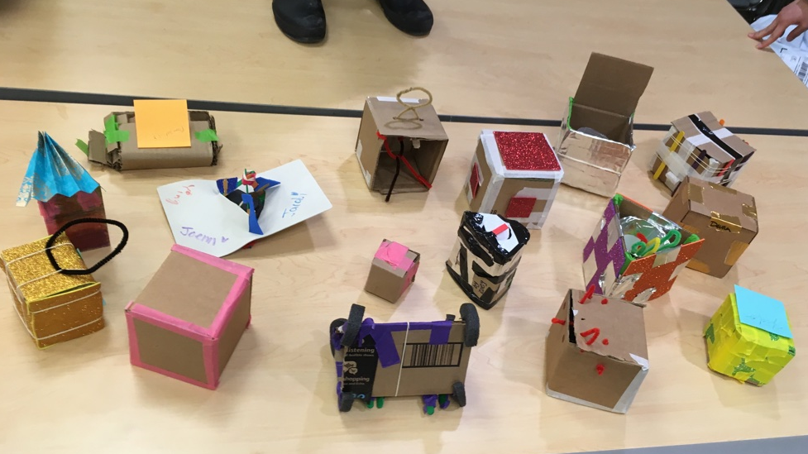
Activity - Let’s build our own CubeSats!

Slide 13
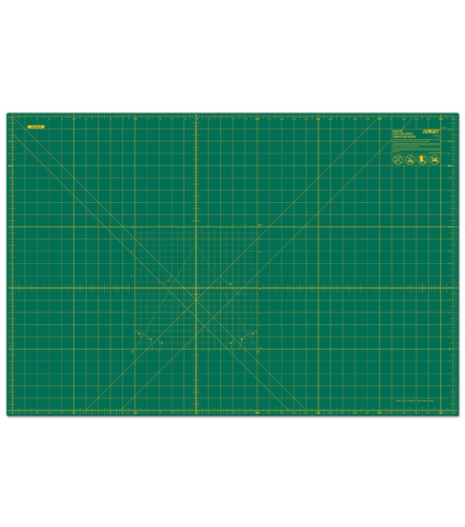
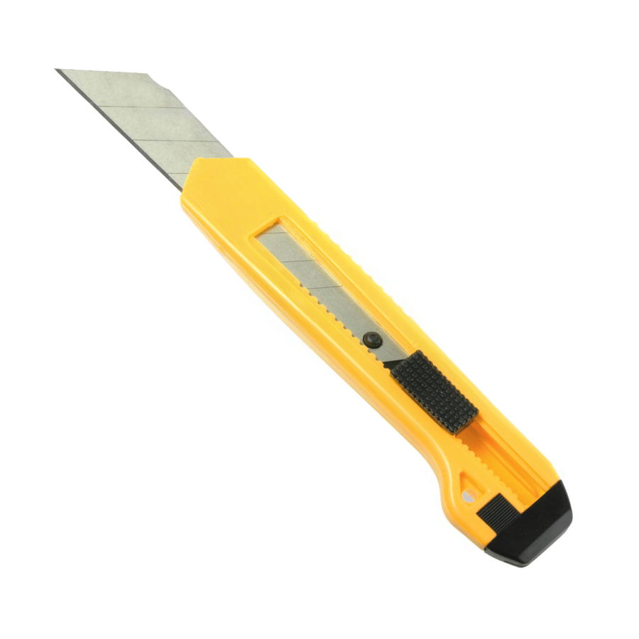
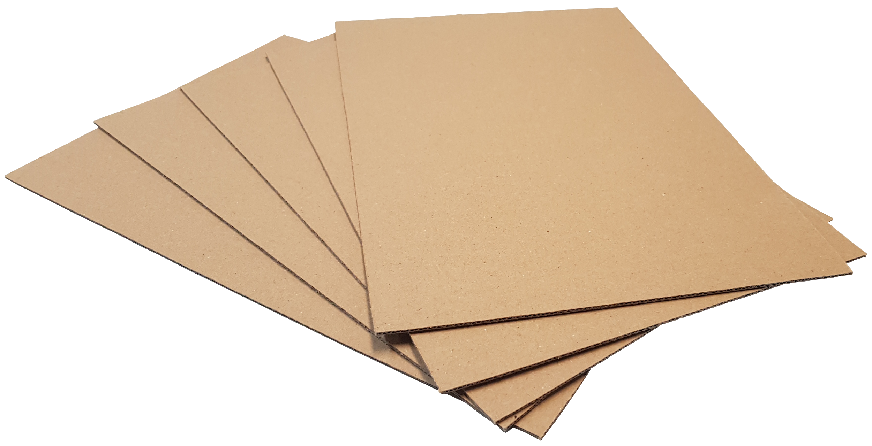
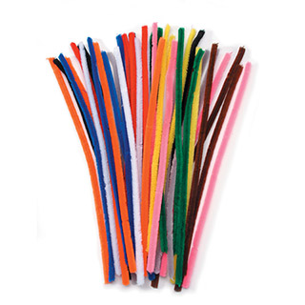
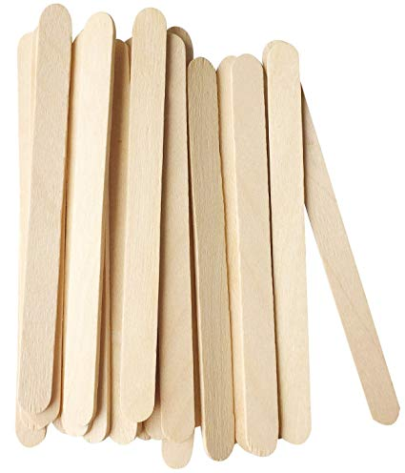
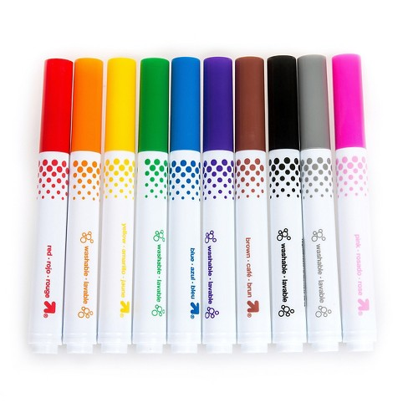
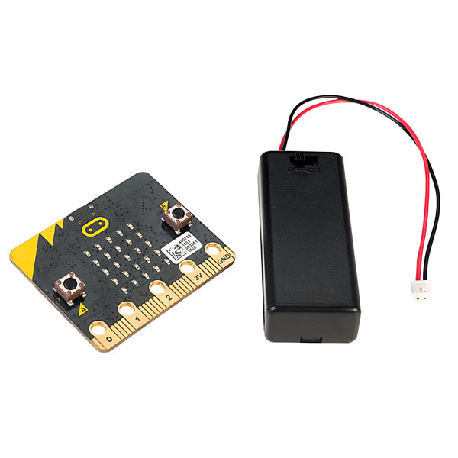
Constructing a CubeSat
Engineering Requirements:
10x10x10 cm cube
As light as possible
A place to put in your microbit and battery
A strong loop (for balloon attachment)
*Show your personality and leave a spot for your patch!*
Materials:
Notes:
Make sure to test their design using a fake cubesat locker that it would launch in (if it cant fit, it cant go to space! Engineering requirements are important! And make sure the cubesats are no more than 3-4 lb.

Slide 14
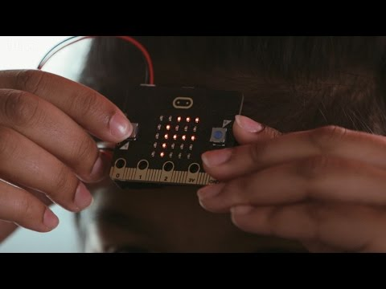
Microbit for satellite computer and communication
Notes:
Show video (optional)

Slide 15
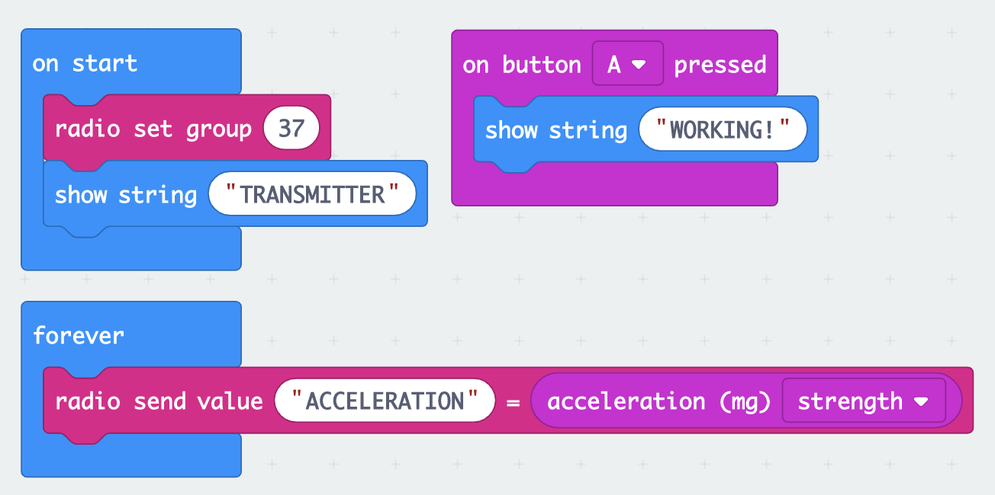
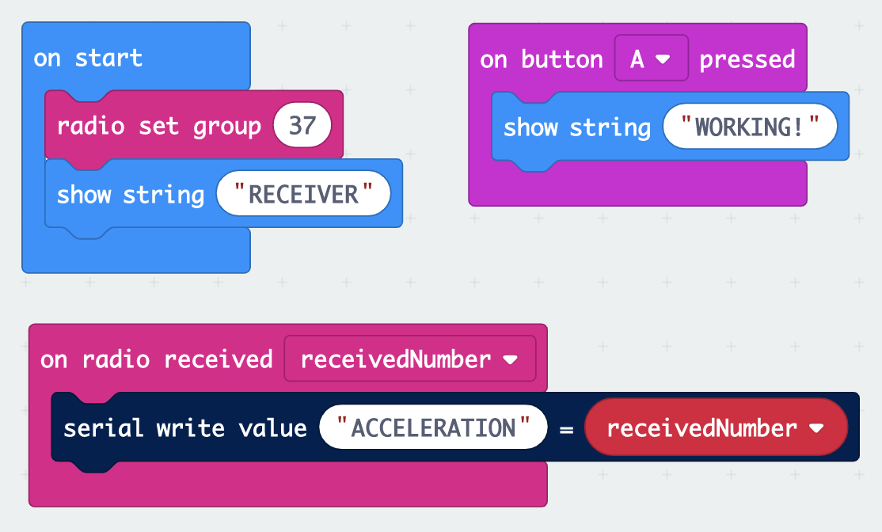
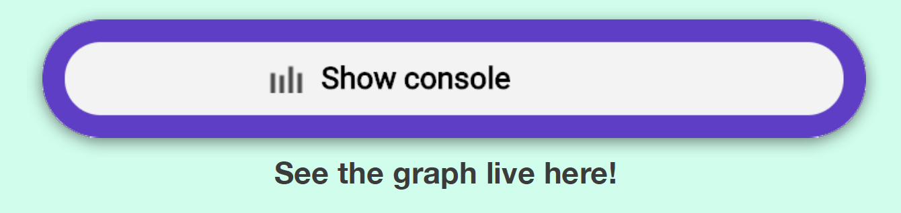

Programming Microbits
Transmitting Microbit:
Receiving Microbit:
Change up the inputs that you are reading!
Notes:
To program the microbits, it should be done sequentially. I would encourage the students to start by programming the transmitting microbit followed by the receiving microbiot. The above is sample code but students should be encouraged to try out the code themselves and add to it (change the input sensor use, change methods of confirming the file was properly flashed, change strings, etc). But make sure that the radio sending and receiving pieces of the program stay as they are (no extra strings being outputted in the loops) or else it slows down the data acquisition.
Students should have the transmitting microbit running on batteries and inside their cubesat and should have the receiving microbit plugged into the computer with the USB so that it can output the data via the console on the computer.
If there is time, have students modify the code to try out different sensors and compare the data they pick up.
Make sure you download the code on BOTH of the different devices (the A button pressing is an extra check for students to confirm)

Slide 16
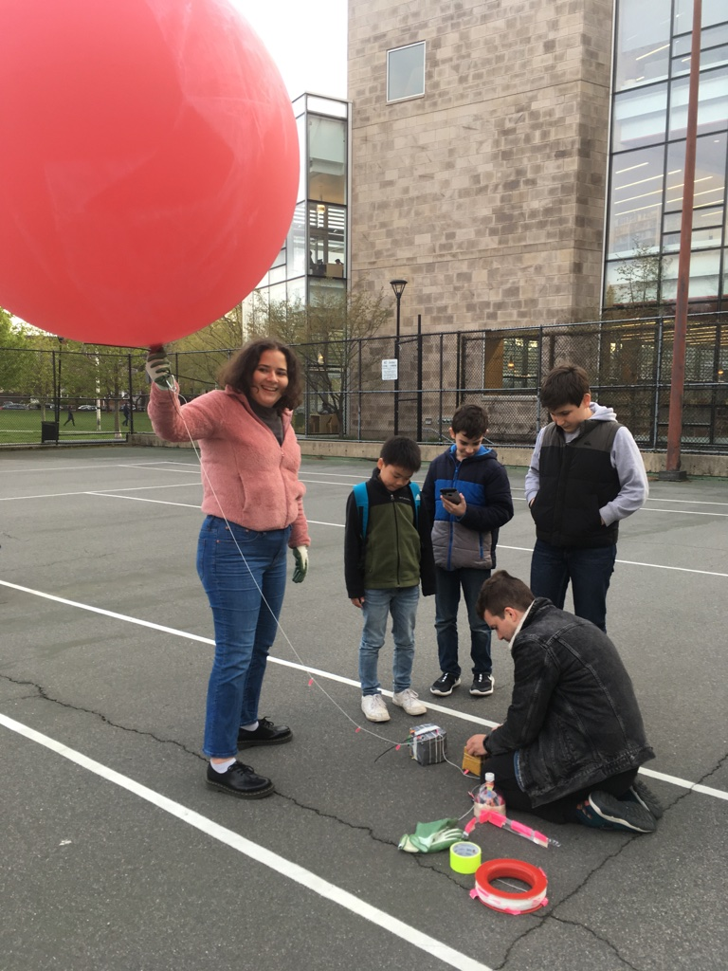
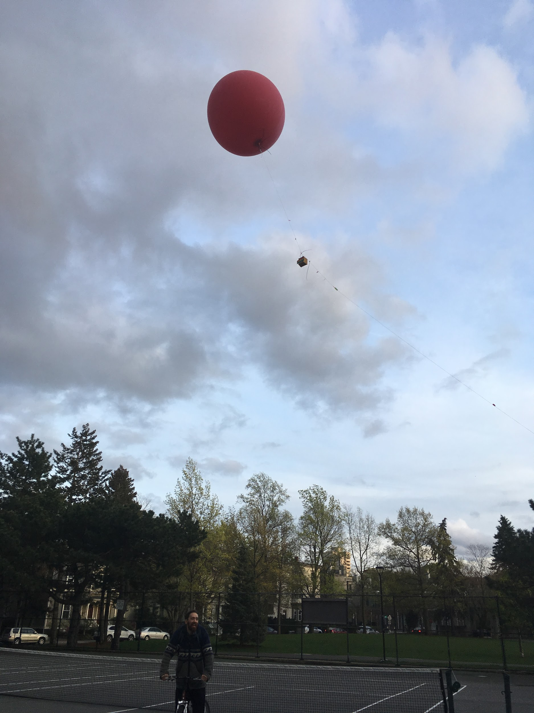
Testing CubeSats on a Balloon!

Slide 17
Extra Slides

Slide 18
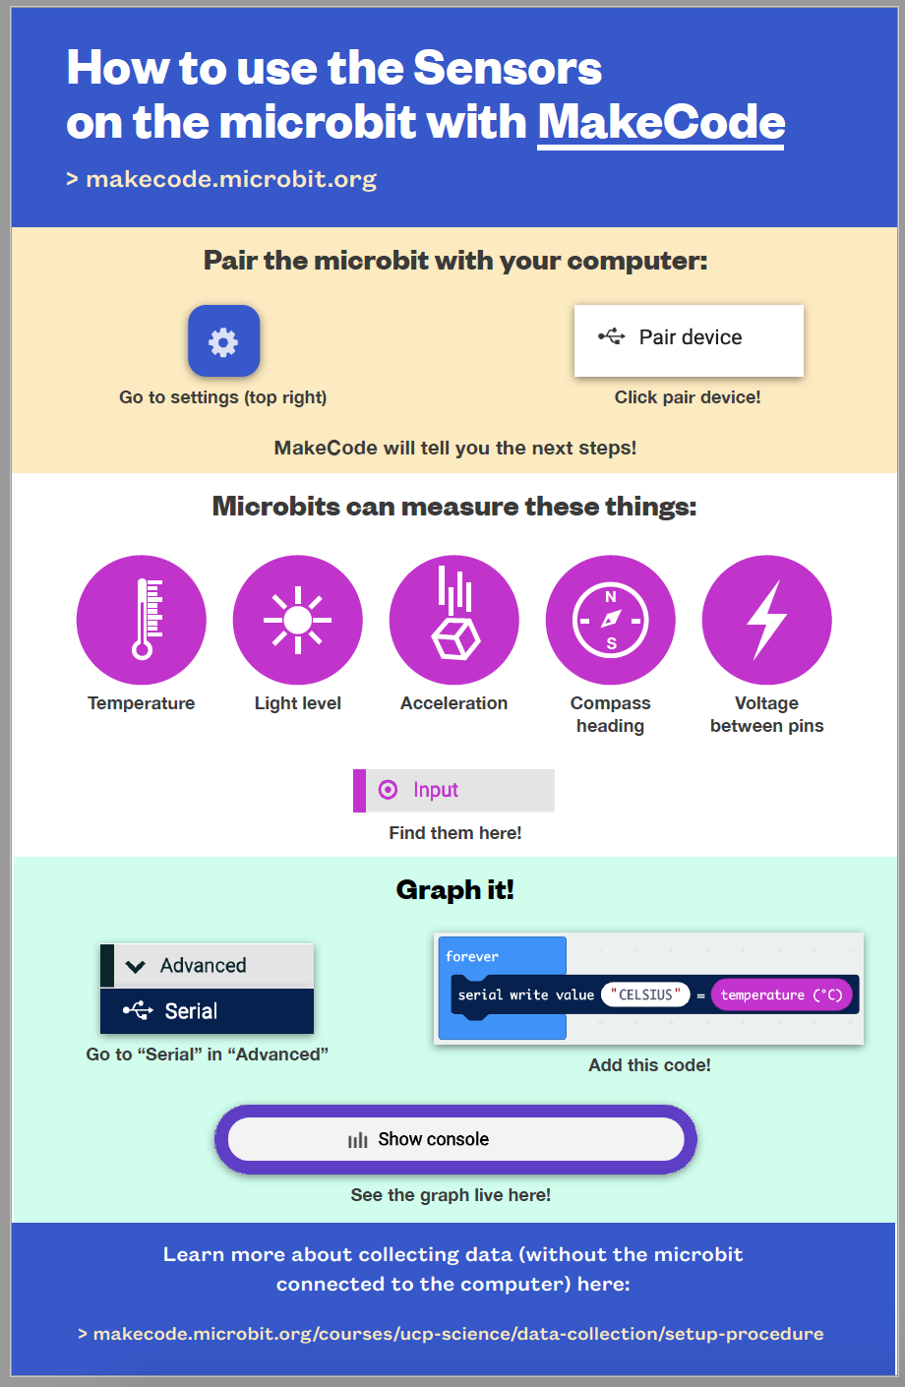
Microbit Instruction Card
Notes:
Credit to Doyung Lee (PLIX) for making this great card! It can be printed out and put on tables for students who need extra help! This is the activity just to get a microbit to show the data from one microbit (so not talking), but it is a good start and shows how students can prepare and download a file!

Slide 19
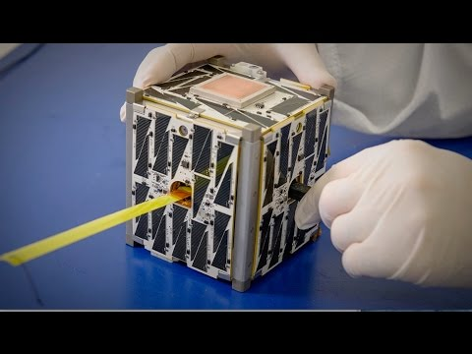
CubeSats
Notes:
You can decide which video you prefer!

